Slide 1

C++ PROGRAMMING
DAY 4

Slide 2
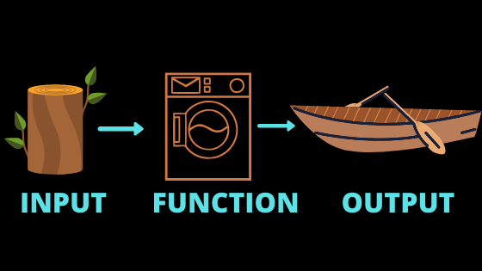
FUNCTIONS

Slide 3
DEFINITION
It gives us the feature to write a code in modular format which can be executed N number of times within a program.
It behaves like void main( ).
It is the trick which gives us the feature to divide the program in different modules.

Slide 4
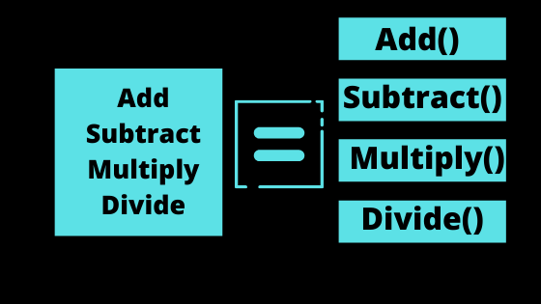
What does that mean ?

Slide 5
MERITS
i. Program execution becomes faster
ii. It makes program easier to debug(rectify).
iii. It nullifies the repetition of the code within a program due to which programs become shorter.
LIMITATIONS
i. It doesn’t share data with other blocks.
ii. It can accept more than one value but it cannot return more than one value at a time.

Slide 6
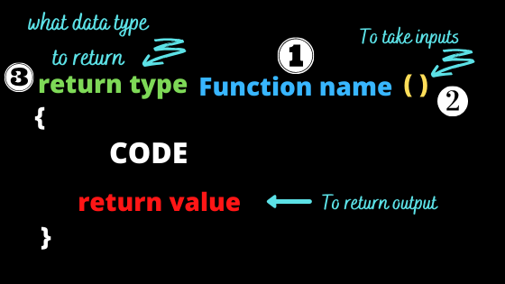
SYNTAX

Slide 7
DECLARATION, DEFINITION, CALLING
// Function declaration
void fun();
int main() {
fun(); // call the function
return 0;
}
// Function definition
void fun() {
cout << "hello world";
}

Slide 8
ACTUAL AND FORMAL PARAMETERS
Actual parameters :- Variables defined within the main block to pass data from mb to fb
Formal parameters :- Variables used for accepting data in function block.
Parameters are also known as signatures.
They play an important role in function overloading.

Slide 9
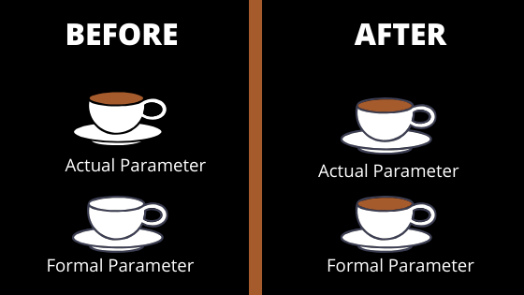
CALL BY VALUE
The data value stored in the actual parameters ( variables that are passed from the main block to the function block) are copied in the formal parameters ( copied in the function block variables).

Slide 10
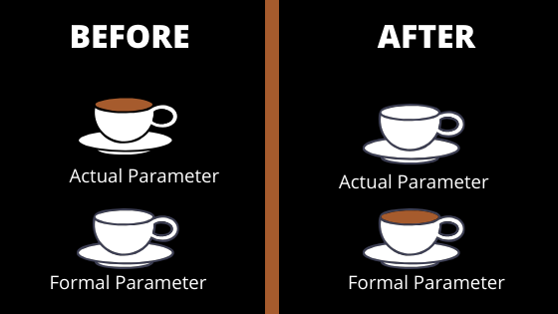
CALL BY REFERENCE
The data value stored in the actual parameters ( variables that are passed from the main block to the function block) are transferred to the formal parameters ( copied in the function block variables).

Slide 11
FUNCTION OVERLOADING
Having multiple functions with the same name in a program and differentiating them on the basis of parameters is called Function Overloading.
Let’s see an example

Slide 12
Application of Function : - Recursion
A function that calls itself is called recursion.
In order to understand recursion you have to understand recursion.
Yes, the above is a recursive statement.
Two rules of recursion :-
Base condition should be defined clearly
The recursive function calls should move towards the base condition with each recursive function call.

